Slide 1
Functional Programming
for Object Oriented Programmers
Jeremy Bellows https://twitter.com/JeremyBellows

Slide 2
What is in this presentation
What is Functional Programming?
How to think as a Functional Programmer?
Some basic F# syntax
Solving a simple problem in F#!

Slide 3
Before we answer what
Functional Programming is….
Notes:
We have to talk about Object Oriented programming. root listeners on a common ground so you can proceed forward.

Slide 4
Programming is...

Slide 5
Part Logic Part Grammar

Slide 6
What is Object Oriented Programming?

Slide 7
Objects
Notes:
OOP is about… Objects have properties, functions, attributes, etc… Characteristics that define what an object looks like and what it can do.

Slide 8
Objects are Nouns

Slide 9
Meet Jeremy…

Slide 10
Meet Jeremy…
he is a person and has legs and can walk

Slide 11
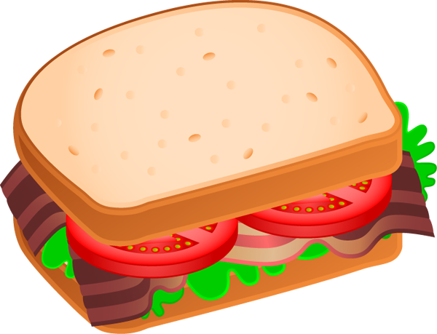
Meet Jeremy…
he is a person and has legs and can walk
he uses these legs to walk to the kitchen…
...and makes himself food

Slide 12
OOP Terms
Notes:
OOP defines what everything is

Slide 13
Meet Jeremy…
[noun]
he is a person and has legs and can walk
[noun]
[noun]
he uses these legs to walk to the kitchen…
[noun]
[noun]
...and makes himself food
[noun]

Slide 14
Meet Jeremy…
[object]
he is a person and has legs and can walk
[interface]
[objects]
he uses these legs to walk to the kitchen…
[objects]
[object]
...and makes himself food
[object]

Slide 15
Functional Programming Terms
Notes:
Functional Programming cares about verbs. not what but how

Slide 16
Meet Jeremy…
he is a person and has legs and can walk
[verb]
he uses these legs to walk to the kitchen…
[verb]
...and makes himself food
[verb]

Slide 17
To make a sandwich…

Slide 18
Start with bread...

Slide 19
Start with bread...
Add peanut butter...

Slide 20
Start with bread...
Add peanut butter...
Add jelly...

Slide 21
Start with bread...
Add peanut butter...
Add jelly...
Add bread...

Slide 22
Start with bread...
Add peanut butter...
Add jelly...
Add bread...
Sandwich!!!

Slide 23
Function Signatures
Notes:
The process of something is called...

Slide 24
Bread -> Peanut Butter -> Jelly -> Bread -> Sandwich

Slide 25
Object Oriented Programming
Describes what something is
A sandwich is multiple ingredients between two pieces of bread
Functional Programming
Describes how something works
Add bread, ingredients, bread, get sandwich!

Slide 26
Both Paradigms Need Nouns and Verbs
Notes:
Both needed. The difference is the focus (first class citizens)

Slide 27
Types and FSharp

Slide 28
F# Types
Abbreviations/Aliases
Records
Classes
Interfaces
Tuples
Discriminated Unions
Enum
Struct
The Nouns

Slide 29
Immutable State

Slide 30
Program

Slide 31
Program
Function A
Variable X

Slide 32
Program
Function A
Function B
Variable Y

Slide 33
Program
Function A
Function B
Variable Y
Variable X
Notes:
scoping

Slide 34
Program Starts -> Function A -> Function B -> Something

Slide 35
Discriminated Unions
What is your favorite color?

Slide 36

Discriminated Unions

Slide 37
Pattern Matching

Slide 38
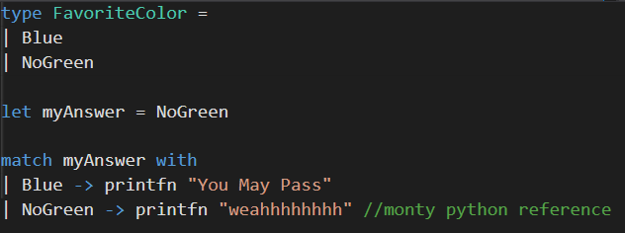
Discriminated Unions

Slide 39
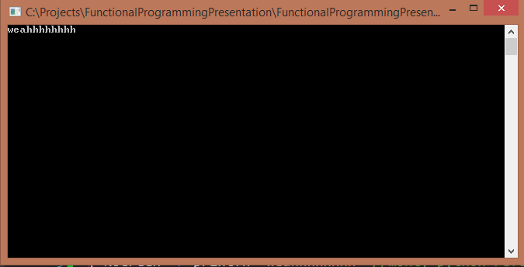
Discriminated Unions

Slide 40
The Option Type

Slide 41

Free from Nulls!

Slide 42
I’ve got a lot of something
Some
I’ve got a lot of nothing
None

Slide 43
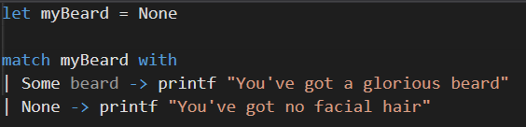
Option type

Slide 44
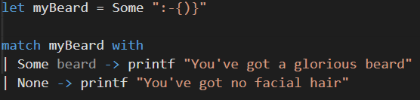
Option type

Slide 45
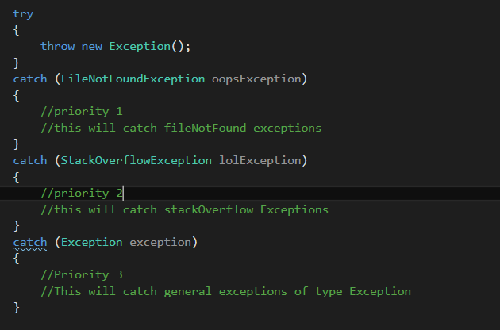
Try Catch C#

Slide 46
Try Catch C#

Slide 47
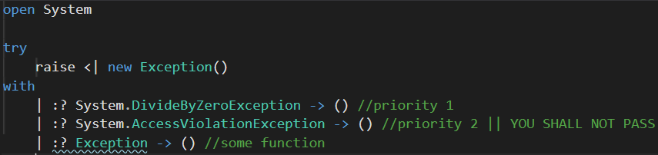
Try Catch F#

Slide 48
Try Catch F#

Slide 49
Let’s talk Sandwiches

Slide 50
Object Oriented Programming
<<interface>>
iIngredient
<<Implementation>
Peanut Butter
<<Implementation>>
Jelly
<<Implementation>>
Bread

Slide 51
Object Oriented Programming
SandwhichMaker : Class
Ingredients : List<iIngredients>
void AddIngredient(iIngredient ingredient)
Sandwhich FinishSandwhich()

Slide 52
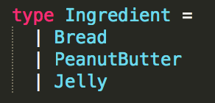
Functional Programming
Ingredient List -> Sandwich
Bread -> Ingredient List -> Sandwich

Slide 53
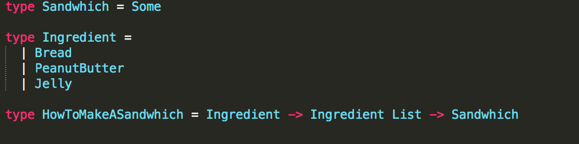
Functional Programming

Slide 54
Let’s Solve a Problem!

Slide 55
Before we start...
There is no ‘void’ type
only the ‘unit’ type

Slide 56
I only need even numbers!
I need a program that
Filters the list to only contain even numbers
prints the even numbers
List:
[ 994 551 386 79 850 155 466 953 903 17 930 344 805 898 744 ]

Slide 57
Let’s Solve another Problem!

Slide 58
I want data for my excel sheet!
For some reason, Deli’s love using excel sheets! They want us to consume json sent by their undocumented api and convert the data into a csv file.
Consumes json from a mocked endpoint
Prints all fields of each item in a csv format
jsonData -> parser -> writeCsv -> unit

Slide 59
Things to Google Later
FSharp
FSharp types
FSharp for Object Oriented Programmers
FSharp Pattern Matching
FSharp Lists
FSharp Option
FSharp null
Where is the nearest sandwhich shop?

Slide 60
Further Reading
http://fsharp.org/
http://fsharpforfunandprofit.com/
http://fsharpforfunandprofit.com/posts/why-use-fsharp-intro/

Slide 61
What we learned today
Objects are nouns
Functions are verbs
Functional Programming is the art of thinking in verbs
Function signatures are the composition of verbs
Functional programming is another way to perceive the world!

Slide 62
Thank you!
Slides and Code can be found at
https://github.com/JeremyBellows/DallasTechFestFpForOOP

